Slide 1
ISV Data Camp HOL Requirements
Part of the experience at the ISV Data camps is a collection of hands-on-labs. To get the best value from these HOLs you’ll need a paid Azure account
MSDN accounts won’t work with Azure Search and will cause the day-1 labs to fail
Corporate accounts (Azure Active Directory) typically bring other challenges
We strongly recommend you create a new MSA (LiveID) fred@outlook.com and use this for the HOLs

Slide 2



Redeeming a Microsoft Azure Pass

Slide 3
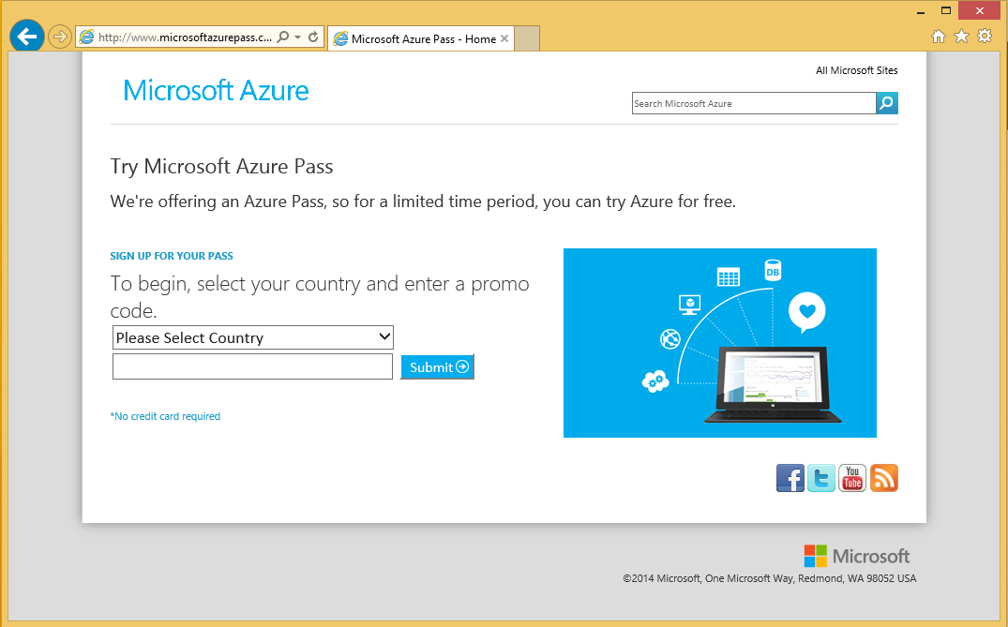
Open a browser and navigate to: www.microsoftazurepass.com
Only one promo code can be redeemed per the life of a liveID. (Pass exclusions: Third party services, Premier Support, Azure Store and liveID cannot be affiliated with an EA account)

Slide 4
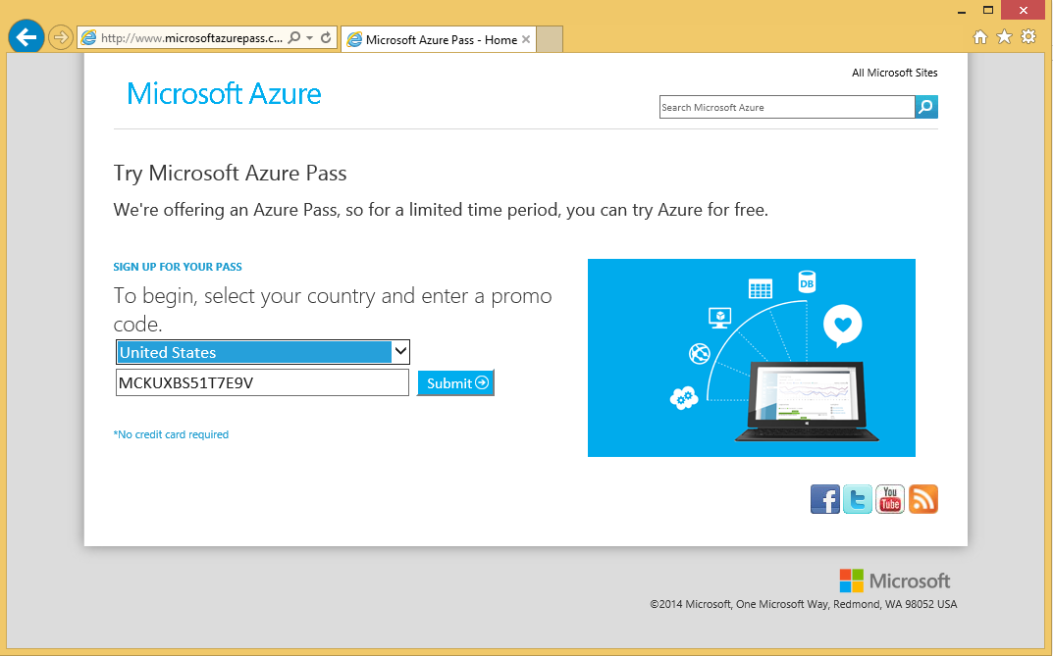
Select your country in the drop down menu Enter your Azure Pass Promo Code Click ‘Submit’

Slide 5
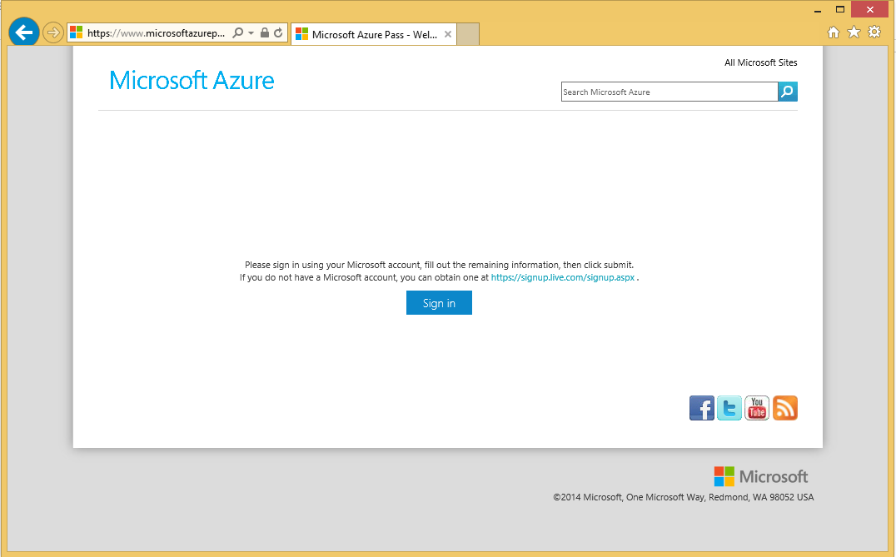
Click ‘Sign in’ to sign into your Microsoft Account (LiveID) The Azure subscription will be created in this account If you do not have a Microsoft Account then you can create one by clicking on the link

Slide 6
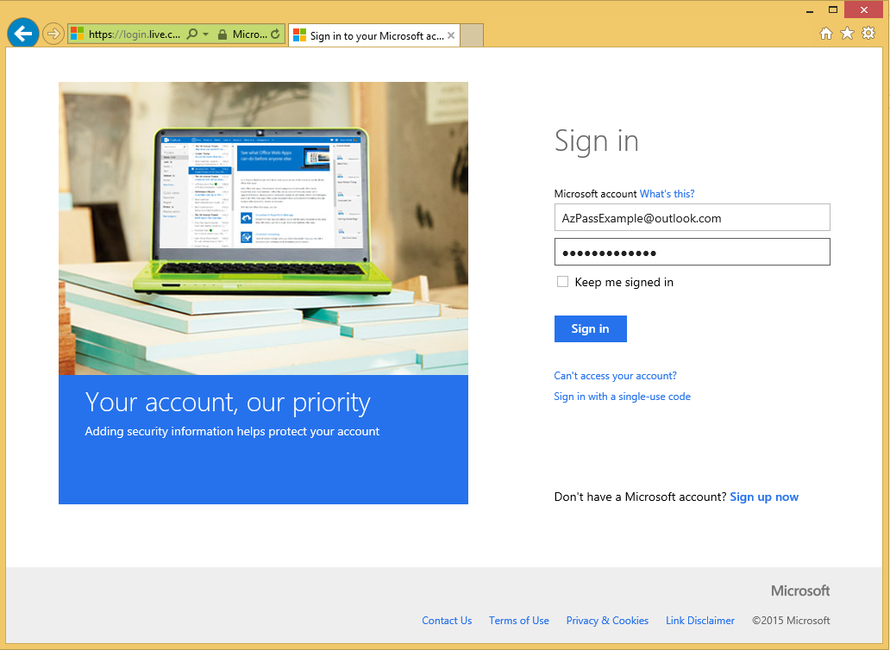
Sign into your Microsoft Account

Slide 7
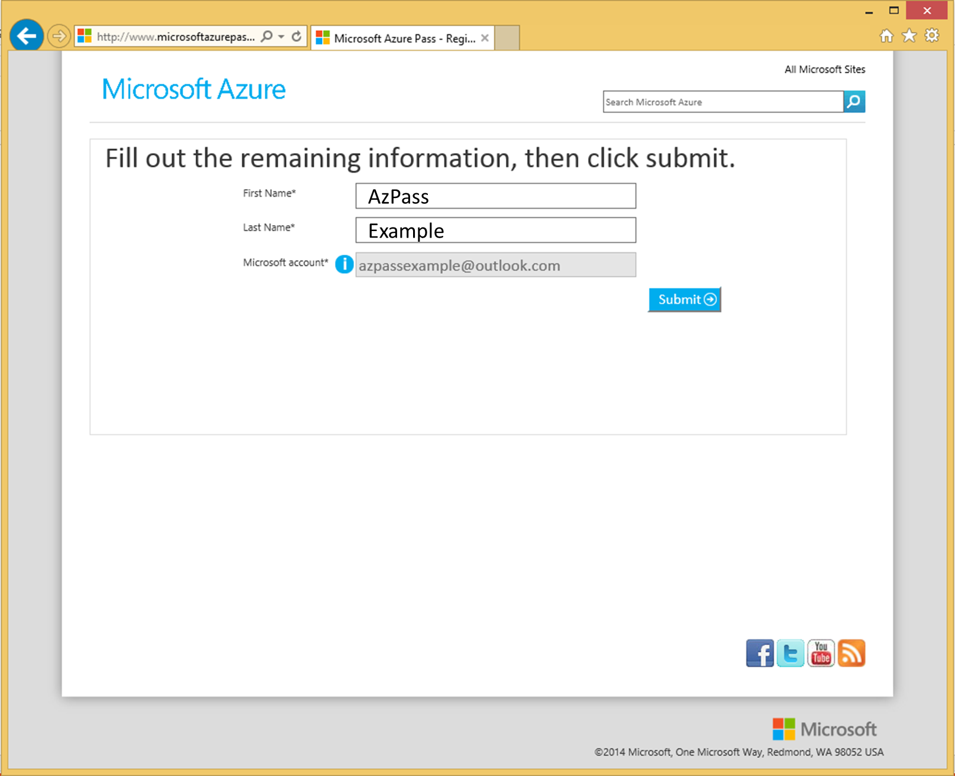
Click ‘Submit’

Slide 8
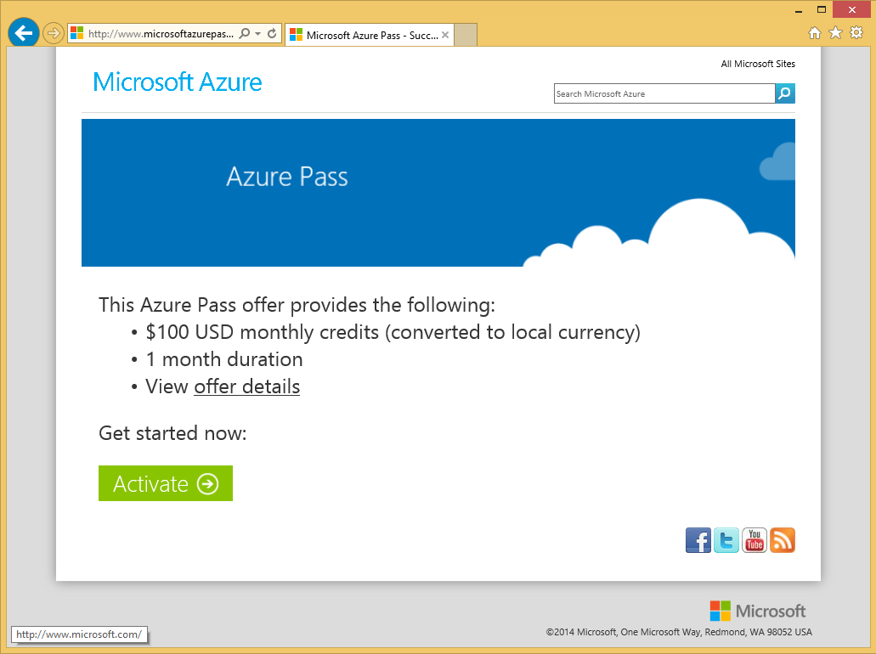
Click ‘Activate’

Slide 9
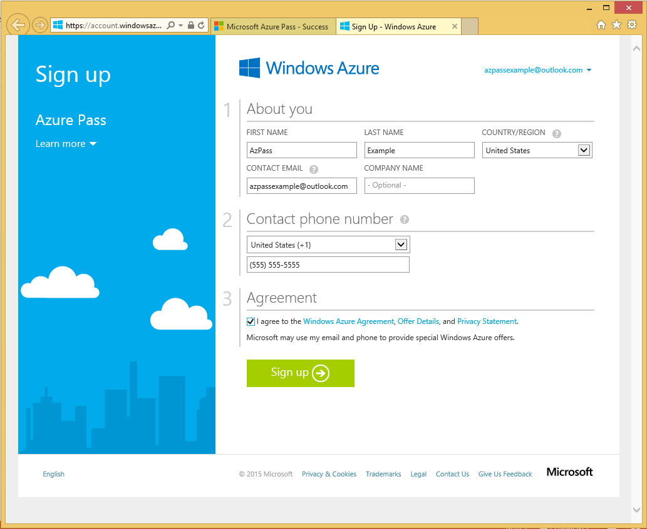
Fill Out the Requested Information This needs to match your account information Click ‘Sign up’

Slide 10
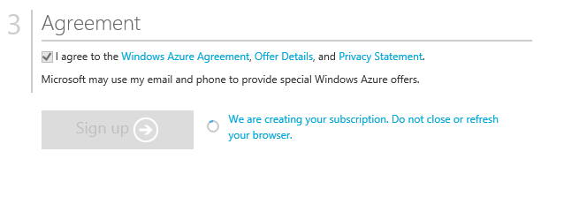
It make take a few minutes, DO NOT refresh or close your browser

Slide 11
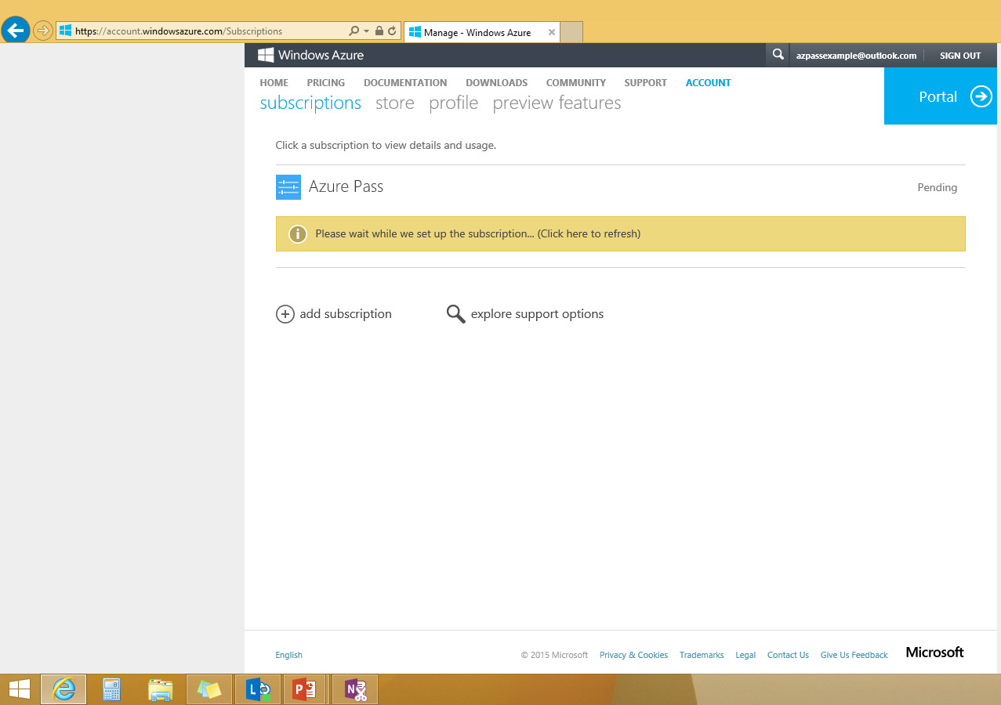
Your subscription has been created and is being provisioned, this can take up to 10 minutes. If it takes longer, reach out to support. You may need to refresh the page After your subscription is provisioned you can start using by clicking ‘Portal.’ In the future you can navigate directly to the management portal: http://manage.windowsazure.com

Slide 12
Creating a New Microsoft Account

Slide 13
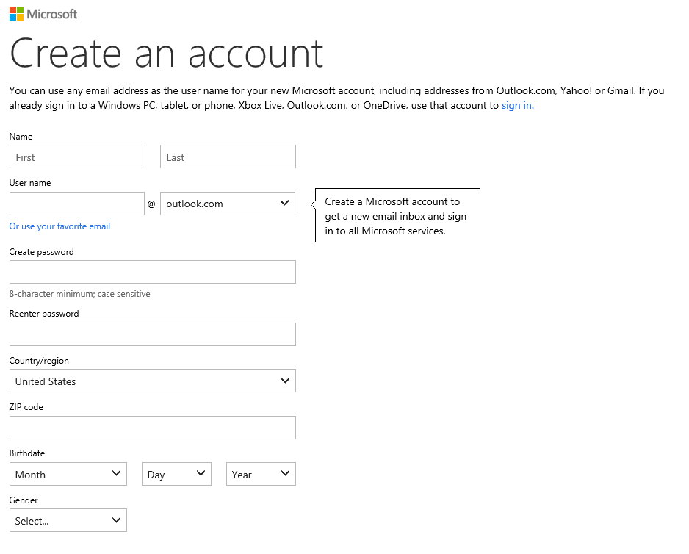
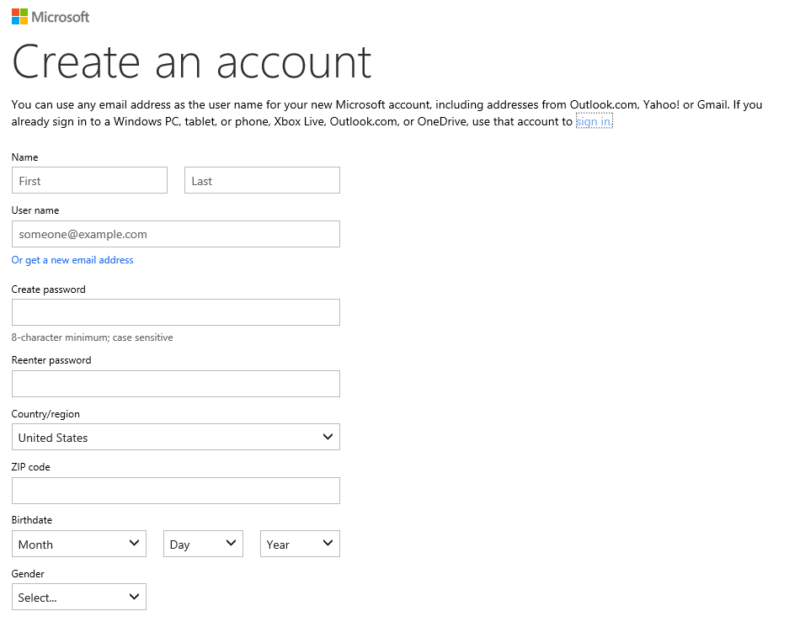
You can create a new Microsoft Account, or you can use an existing email address.
New Microsoft Account
Existing Email

Slide 14

© 2013 Microsoft Corporation. All rights reserved. Microsoft, Windows, Windows Vista and other product names are or may be registered trademarks and/or trademarks in the U.S. and/or other countries.
The information herein is for informational purposes only and represents the current view of Microsoft Corporation as of the date of this presentation. Because Microsoft must respond to changing market conditions, it should not be interpreted to be a commitment on the part of Microsoft, and Microsoft cannot guarantee the accuracy of any information provided after the date of this presentation. MICROSOFT MAKES NO WARRANTIES, EXPRESS, IMPLIED OR STATUTORY, AS TO THE INFORMATION IN THIS PRESENTATION.

